Slide 1
We do the f & I for you!

Slide 2
F&I doesn’t have to be SCARY. We’ll handle it for you!
Vantage provides turn-key F&I services, online and over the phone.
We are a convenient & effective service that has been helping independent dealerships tackle the F&I world since 2010.

Slide 3
Vantage Finance
1812 N. 203rd Street Elkhorn, NE 68022 P: 402-315-3329 F: 888-315-1823 info@vantagefinance.com www.vantagefinance.com

Slide 4
Becoming a Partner We don’t just provide you with an approval, we’re there from credit application to lien perfection!
24 hour access to the Vantage Finance Portal
Only $49 Monthly Fee!
Dealer May Earn Back End Profits! The more deals you do, the more backend you earn!
Dealer Retains 100% of Front End less a $239 Vantage Fee & Lender acq. Fee if deal funds
ACH Funding – Get YOUR money Faster!
Access to all of Vantage’s point of sale Lenders
Enjoy participating in yearly & monthly promotions and bonuses that help you earn more!
Improved decisioning matrix for quicker turnaround and approval process
Full spectrum of lending sources. Access to prime, non-prime & subprime lenders!
10 year old units OK!!!
Up to 140,000 miles OK!!

Slide 5
1. New Dealership Sign-Up Process
2. Username & Password
3. Dealer Submits Credit Application to Vantage
4. Vantage’s F&I Credit Team Reviews Application
Dealer’s fill out a login credential request form and credit card authorization form to begin submitting credit applications.
Dealer’s must provide Vantage with a complete dealer sign up package with original signatures prior to funding. (Please refer to Dealer Requirements for a complete list of what is required to sign up with Vantage.)
Once dealer receives login info via email they may begin sending credit applications.
Credit Applications may be submitted the following ways:
Vantage Portal (Preferred)
Fax
Over the Phone
Credit bureau pulled at this time
Customer interviews conducted
Contacting dealership to verify structure and gather additional info (if applicable)
Appropriate lender selected
Work with lender to maximize front end advance and back end opportunity for dealer.
7. Deal Forms & Requested Stips Must be Shipped to Vantage for Funding
5. Application Decisioned by Lender
6. F&I Delivery Specialist
A complete Funding Packet includes all deal forms that print from the Vantage system, original signatures, and all requested stipulations. The funding packet once complete needs to be shipped immediately to Vantage for funding. 1812 N. 203RD Street, Elkhorn, NE 68118
Follow provided checklist & notes from system to ensure you send all required documents. Stips must be less than 30 days old and validate requested info.
Make sure all documents are signed properly and appropriate copies have been made for customer and dealership.
Incomplete funding packets may result in funding delays
Dealers may fax entire deal in ahead of shipment for internal checking of stips and signatures & to start the funding process.
Vantage cannot fund until it has originals
Lender issues decision on application
Dealer may now access decision on the Vantage System
Dealer and Vantage discuss how to proceed. If deal works for dealer & customer, deal is built and F&I process continues.
F&I representative will assist the dealer in finishing deal
Verification of Information
Disclosures & Product Presentations
Delivery/Printing Forms/Signup
Continued on next page...

Slide 6
8. Vantage Receives Funding Packet (Deal Forms)
9. Funding Packet to Lender
10. Lender Funds Vantage
11. Dealer Perfects Lien
Dealer provides Vantage with proof of lien perfection sent to: Titles@vantagefinance.com or
Fax to: 888-511-3294
Vantage Funding Dept. reviews packet to ensure it’s completeness. Then forwards to lender.
If funding packet is incomplete or missing any items the Vantage funding dept. will notify dealer
Incomplete funding packets may result in funding delays.
Vantage Finance will pay off any trade in vehicle with proceeds of the contract.
Dealer can remit payoff on the trade in. Once account is verified $0 balance, Vantage will advance all funds to dealer via ACH.
12. Dealer is Paid Frontend
Dealer receives funds immediately upon lender funding Vantage and dealer providing Vantage with proof of lien perfection. Respective state DMV must validate lien prior to funding.

Slide 7
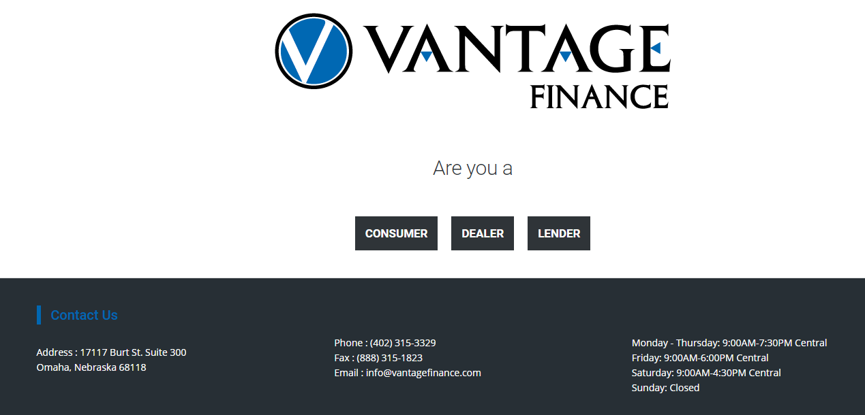
Logging On To Vantage Finance
In your Google Chrome web browser type in our web address www.VantageFinance.com
Enter username & password provided by the Vantage. No pin needed, simply leave this field blank.
For additional information about our Dealership program, click the black “Dealer” button.

Slide 8
Dealer Dashboard Here is where ALL your submitted applications are recorded
Click Here to enter in New Credit App
Search for a Deal: change “Date From” to the date you originally entered in the app then select “GO”
Or you can select “Track Progress” for a quick search

Slide 9
Entering a Credit Application All asterisks (*) are Required Simply fill out the ONLINE Application Check the box at the end of the app and then click the submission bar at the bottom of the page

Slide 10
Entering a Credit Application All asterisks (*) are Required Simply fill out the ONLINE Application Check the box at the end of the app and then click the submission bar at the bottom of the page

Slide 11
Entering a Credit Application All asterisks (*) are Required Simply fill out the ONLINE Application Check the box at the end of the app and then click the submission bar at the bottom of the page

Slide 12
Entering a Credit Application Simply fill out the ONLINE Application. All asterisks (*) are Required Check the box at the end of the app and then click the submission bar at the bottom of the page
1. Complete entire credit application.
3. Click to Submit Credit Application to Vantage
2. Review Privacy Policy & Disclosures. Customer must place name in field agreeing to all of the terms and conditions

Slide 13
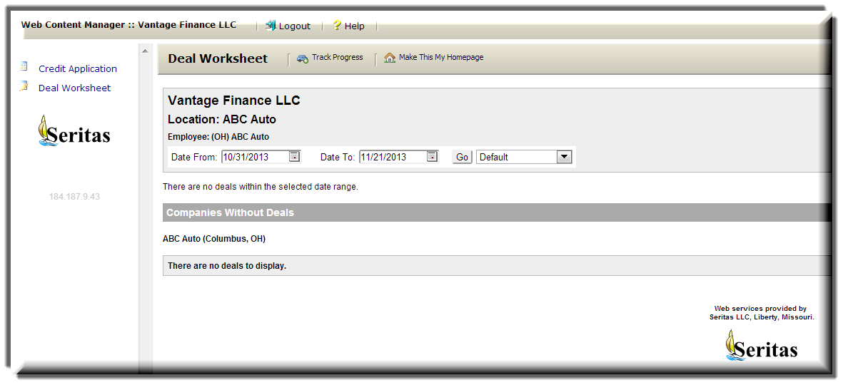
Monitoring the progress of a credit application that has already been sent to Vantage...
Once a credit application has been sent to Vantage, the ONLY way to monitor its progress is through the Vantage System. To monitor the progress of your pending credit application, click on “Deal Worksheet”

Slide 14
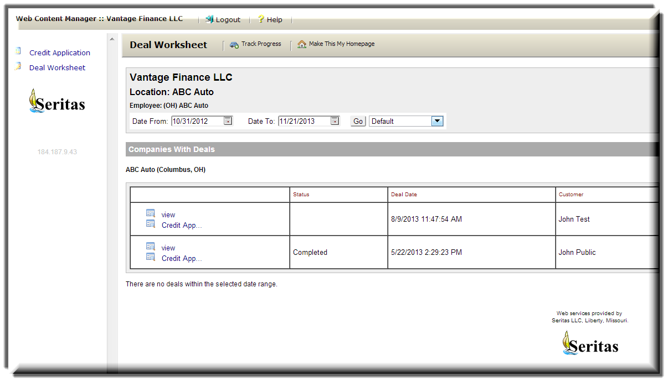
Monitoring the progress of a credit application that has already been sent to Vantage...
Click On “Track Progress”
You will notice to the left that this Deal Worksheet area lists deals similarly to credit applications.
Do not confuse these items.
What you are looking at here is showing the Docs Recvd status is actually a car deal that’s in for funding.
To monitor credit applications you must go to the track progress area.
Docs Recvd

Slide 15
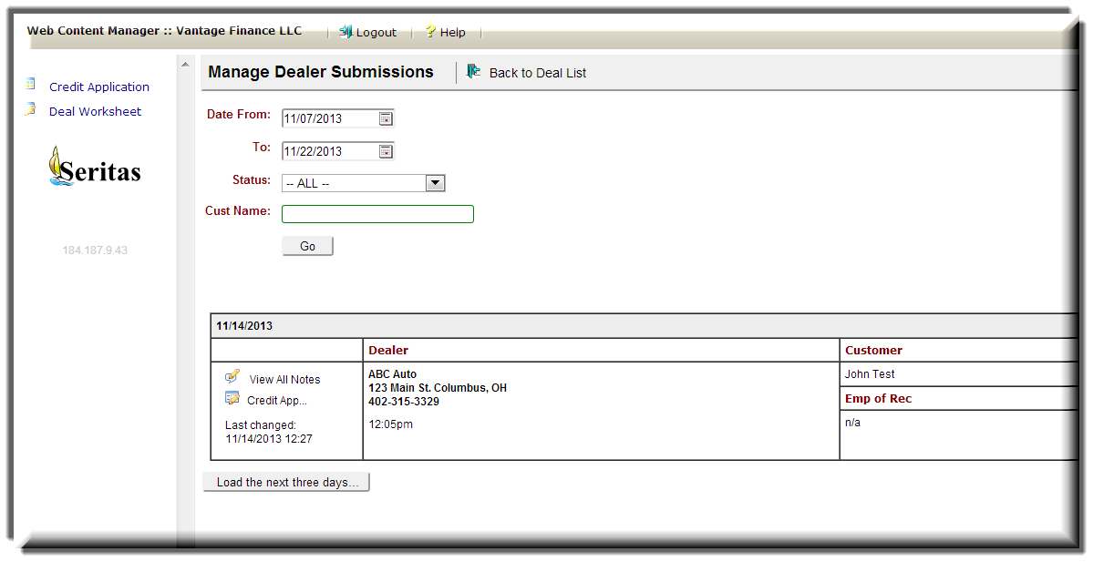
Monitoring the progress of a credit application that has already been sent to Vantage...
Locate the credit application you want to monitor…
If you cannot find a specific credit application try adjusting the date range and other search parameters. If you still cannot find it, try re-entering it as it may not have been received.

Slide 16
Monitoring the progress of a credit application that has already been sent to Vantage...
Now that you’ve found your credit application in the Track Progress area of the Vantage System, let’s discuss in details what each item represents and how to interpret the information Vantage provides you. Below is a credit application that is currently pending for Customer JOHN TEST. Take some time to familiarize yourself with the different fields and what they represent.

Slide 17
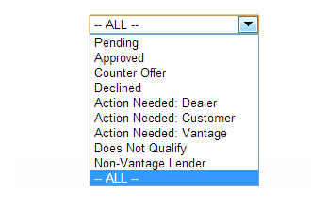
Monitoring the progress of a credit application that has already been sent to Vantage...
Note Section: Check here for messages from Vantage regarding approvals, requested stipulations, deal conditions/structure, action needed details, etc. from our Vantage team members regarding your credit application.
Credit Application: will take you back into the credit application you submitted to Vantage. If you need to review, add a co-buyer or switch units, simply click on credit application blue link to reenter and make necessary changes.
Time: time stamp reflects when the most current changes or updates to the credit application occurred.
Dealer: Dealership name and other dealer specific information is stored here.
Time Vantage received credit application.
Customer: Customer/Buyer’s name
Emp Of Rec: EOR (Employee of Record), is the Vantage representative currently working the credit application.
VIN #
Mileage: Purchased Vehicle’s Mileage
CS: Credit score of buyer
CS2: Credit score of co-buyer (if applicable)
Decision: This is the current status of the deal. Note that the example credit application above is in Pending Status. To the right is a list of Decision Status’.

Slide 18
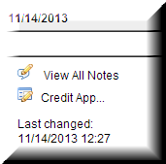
Monitoring the progress of a credit application that has already been sent to Vantage...
Once a credit application has been decisioned, check the notes and the structure (if approved/counter) to determine how to proceed with the deal.

Slide 19
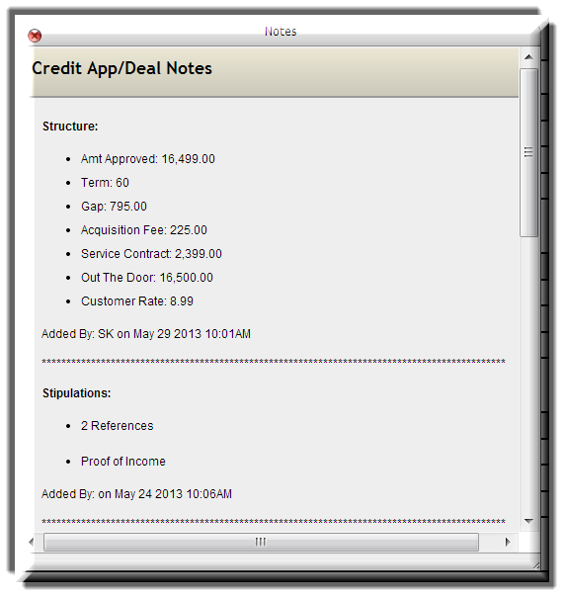
Monitoring the progress of a credit application that has already been sent to Vantage...
Review this area for notes on the credit application; deal structure, acq. fees, interest rates, requested stipulations, availability of backend, & action needed notes. You can also see which Vantage team member added the notes and what time it was last updated in this area.
The next step is working out the final numbers with your internal Vantage representative. who will then convert the credit application into printable car deal for you!

Slide 20
Credit Application Status
· Pending: Still awaiting a response from lender. Vantage will notify you as soon as a decision has been made.
· Action Needed Vantage: Vantage needs to perform a task (i.e. contact lender, speak with customer)
· Action Needed Dealer: Dealer needs to perform a task or Vantage needs something from dealer. (i.e. exact mileage/vin number) Check notes for additional information.
· Action Needed Customer: Vantage is waiting on something from customer. Please check notes for additional information.
· Approved: Lender approved structure as submitted. Full Call. Contact Vantage immediately and let’s capture this deal!
· Counter Offer: Lender provided a way to go, but did not approve structure/application as submitted.
· Declined: Deal does not qualify with lenders, declined means deal is not going to come together.
· Non-Vantage Lender: Lost deal to an alternate lending institution of the dealership or cash deal for dealership.
· Does Not Qualify: Customer, collateral, etc. does not qualify for a loan. This may be for an array of reasons. Check notes area for additional information.
· Not Captured: Deal was lost, i.e. customer bought from another dealership, deal was not closed, etc.

Slide 21
Deal Status
What the different statues of a deal mean:
Working: Credit application has been converted into a “working” deal. Numbers are still being finalized out between the customer, dealership, and Vantage. During this time Vantage will also be conducting compliance checks and performing product presentations. Once everything has been properly discussed an disclosed, the status will be changed to “completed”.
Completed: The deal is turned to “completed” once all numbers are finalized and you are ready to print forms and deliver vehicle. Note: “Completed” status is the ONLY status in which deal forms are available for printing. This ensures that all the numbers & information have been finalized and verified. If a change needs to be made after forms have been printed, simply contact the Vantage Finance representative you are working with.
Docs Recvd: The Docs Received status is to notify dealers that the funding packet has been received at the Vantage Finance offices.
Funding Delay: This status requires URGENT attention! If your deal is in this status contact the Vantage Finance funding department immediately @ 402-315-3329 ext. 4 or funding@vantagefinance.com . Something is holding up the funding of this deal Please help us resolve the issue(s) immediately. Remember Vantage is on your team, and we want these deals to fund as quickly as possible, as none of us make money until we get this funded! Sending in complete funding packets, with proper signatures, originals, and current qualifying stips that are requested from the lender, play a significant role in funding time. Help us help you, by making sure your funding packets are complete!
Funded: When your deal says “Funded” in the Vantage system, Vantage has ACH’d your account. Please allow 24-48 hours for funds to reflect in your account.
Capped: This is the final status for the deal. Everything should be completed at this time and logged in the accounting system. Please note that Vantage needs your help to make sure the liens get noted. Next you will receive your backend profits on the deal the first week following the close of the business month. Deal breakdowns are available at any status throughout the deal progression, however print the final breakdown once the deal is capped to ensure exact figures for your accounting purposes.

Slide 22
Printing the Deal
Once you’ve located the deal you need to print, click on View to enter the car deal
You must be inside the deal in order to print
Deal must be in “Completed” status
Once in “Completed” status the “Print” button will appear inside the deal window

Slide 23
Printing the Deal
Click Print & a box with the forms will pop-up.
*pre-selected for your convenience
Press “Submit” to generate forms.
Check this box if there is a Cosigner

Slide 24
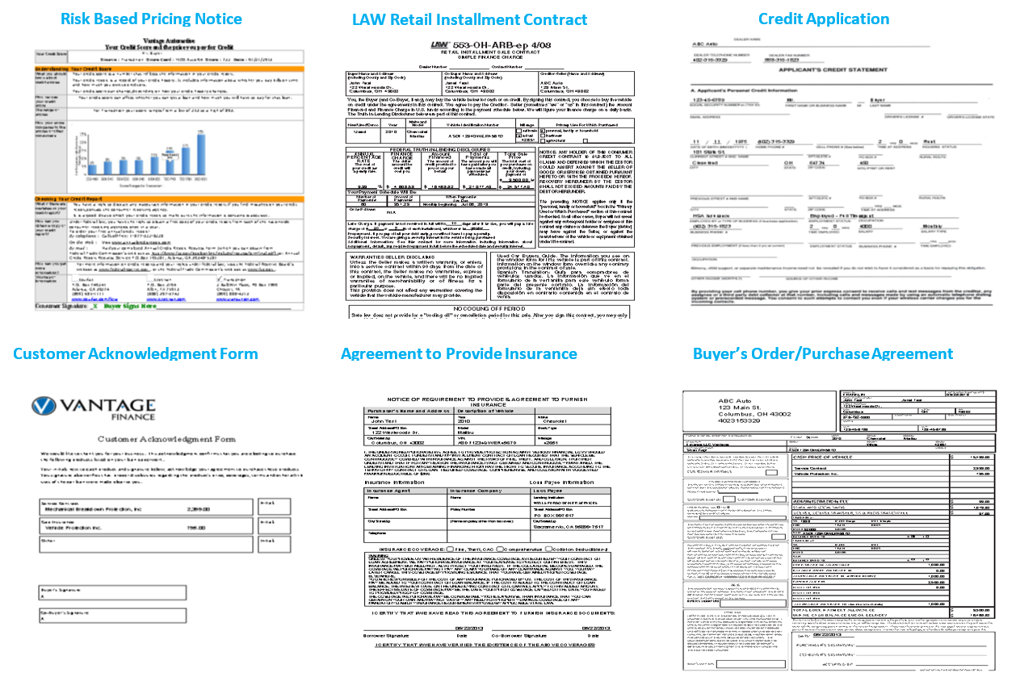
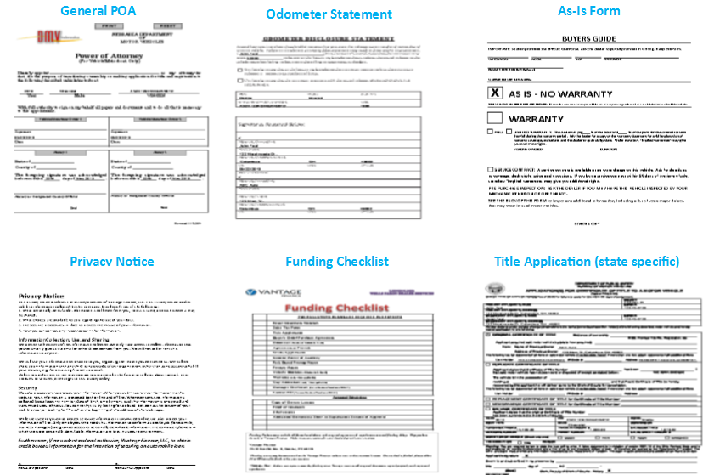
Vantage Finance Forms

Slide 25
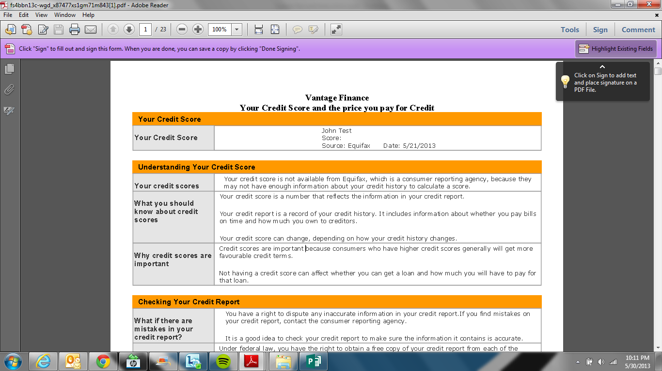
Printing Trouble Shooting
The forms will generate in a PDF file format. Print all of the forms, have customers sign, make copies for dealership and customer, collect all of the requested stipulations, fax into Vantage Finance, and send ALL of the original signatures & documents to Vantage Finance for funding.
Forms should pop up quickly, however if it keeps thinking/processing, check for pop-up blockers, or hold down the control button on your key board and hit submit again. If you find it is a pop-up blocker, select “always allow” pop-ups for this site so that these issues will not occur in the future.

Slide 26
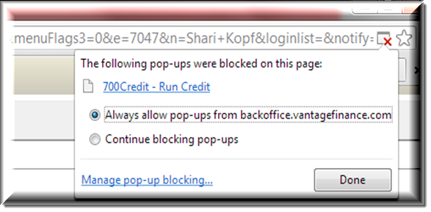
Trouble Shooting Pop-Up Blockers
Often times a pop-up blocker is the culprit in preventing forms, or bureaus from generating.
In the Google Chrome browser, look for a red X to indicate if a pop-up blocker is turned on.
Simply click on the red X in the top right hand corner of your browser, select “Always Allow” and click “Done”.
This should eliminate future issues. If issues persist call Vantage.

Slide 27
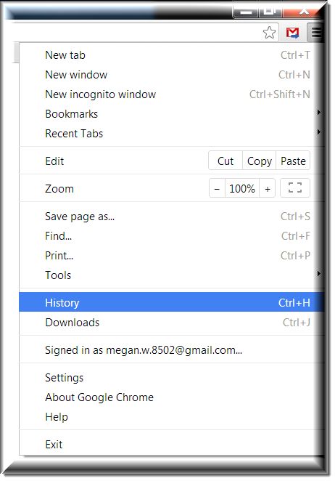
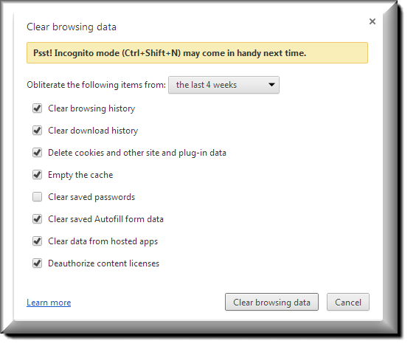
Google Chrome Clearing History
3
1
If you ever have a problem, sometimes clearing your browser history may resolve the issue.
Please follow these steps to clear you browser history:
In your Google Chrome browser, click on the 3 horizontal bars stacked on top of each other in the top right hand corner of your screen.
Select “History”
Select “Clear Browsing History”
Check all boxes, Except “Clear Saved Passwords”
Clear Data from “beginning of time”
Select “Clear Browsing”
2
4

